Slide 1


Educating Practitioners on Accessibility and Data Visualization
2025
frank.computer
Tools, Guidelines, and Approaches to Teaching Basics
Frank Elavsky, PhD Student
hcii.cmu.edu, axle-lab.com, dig.cmu.edu
Notes:
Hey everyone, I am Frank Elavsky, a PhD student and researcher here in Pittsburgh at Carnegie Mellon University. I research, engineer, design, and contribute to standards at the intersection of accessibility and visualization.
I hope that today will be representative of my journey outside of the classroom and with of the challenges I’ve encountered educating practitioners. So, I do work with practitioners a lot. And by practitioner here I mean someone who is not a student and not an academic researcher. These are people who do a specific kind of work in a specific area. For me, these are primarily data visualization and data science practitioners. And in my research, I think about people building and making visualizations all day long. The heart of what I do is about changing the behaviors and outcomes in the ways people build interactive data science systems, tools, applications, products, and services. I believe in this fundamental right that everyone should have: access to data. And also access to understanding the insights we produce from data. And people with disabilities have been excluded from this right. We communicate pandemics with charts and graphs, as well as the state of our elections. Personal informatics from health to finance rely on data visualizations. These artifacts are ubiquitous, virtually everywhere. I want these visualizations, and more importantly the information and decision-making that they enable, to be available for people with disabilities.

Slide 2
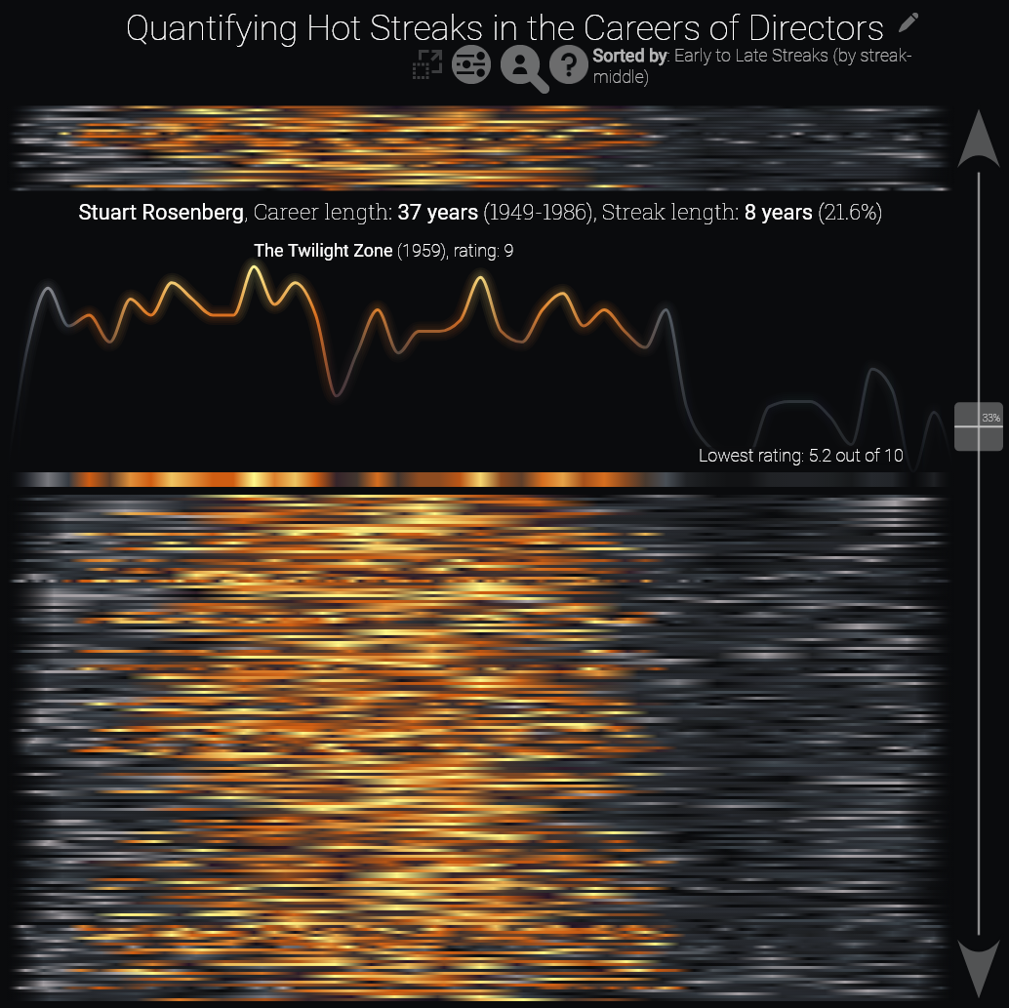
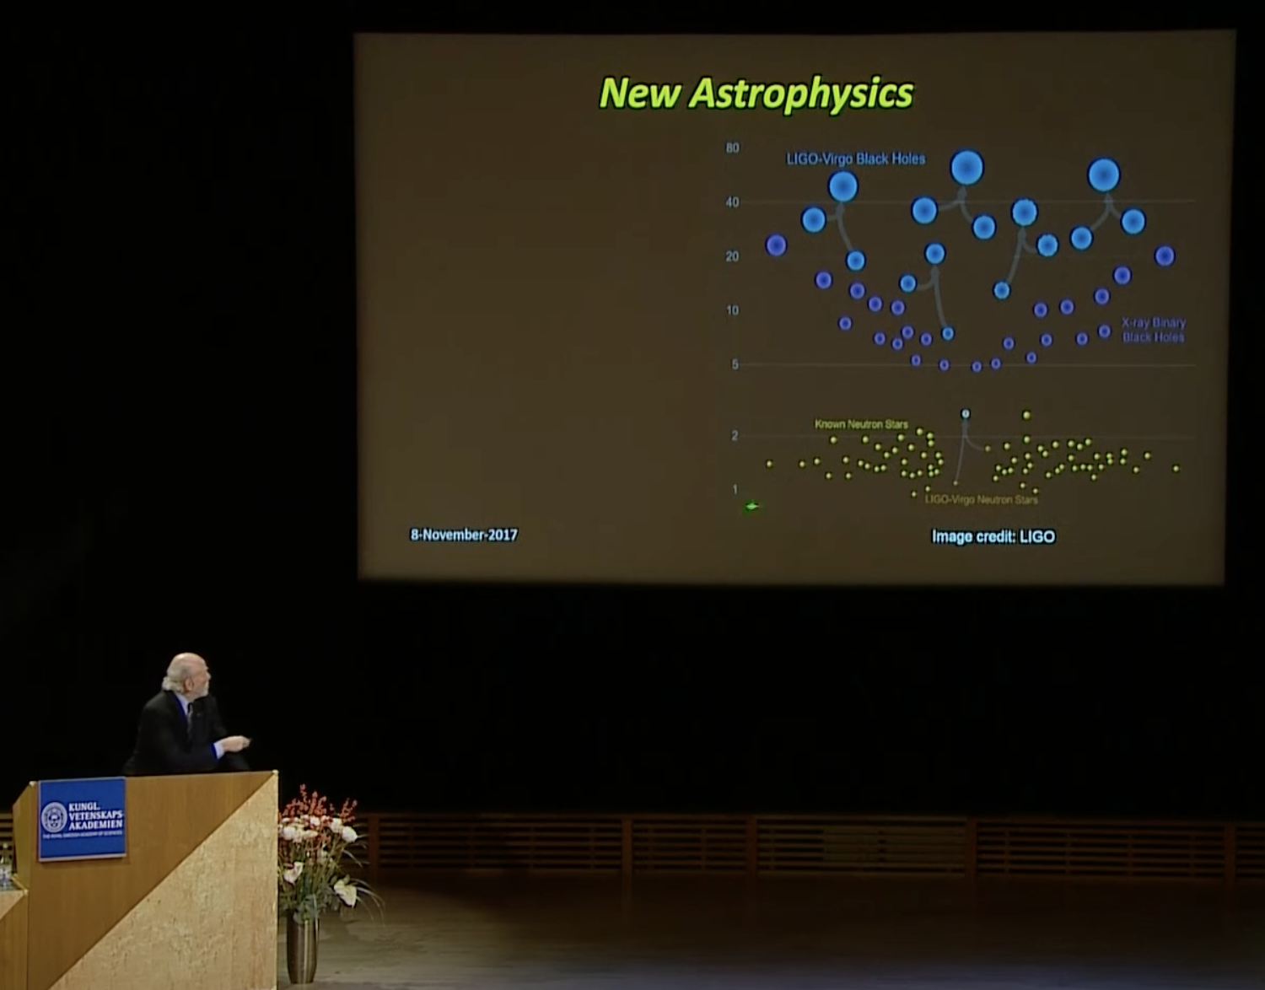
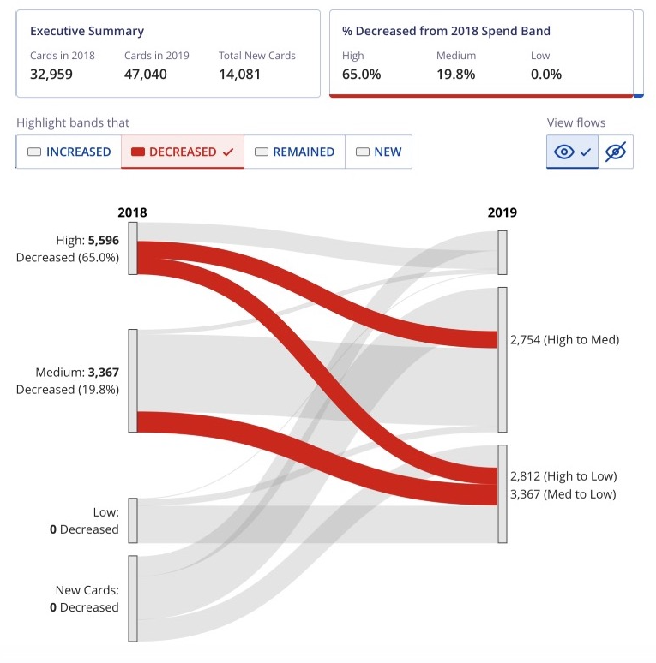
My pre-phd work: supporting others with tools
Industry and research-oriented visualization
Supporting data scientists
Supporting scientists
Supporting engineers
Visualizing a model of over 1m careers
Shown here is Barry Barish giving the Nobel Lecture in
Physics in 2017 with my visualization
Building a chart component library that supports 2000 devs and 200 products in 200 countries
Notes:
So I try to educate people. I of course have spent my phd focusing on this idea of “tool-making” as an intervention. My past career, before I started as a researcher, was also supporting others by making them tools. I’ve been a tool-maker for nearly a decade now.
I did a decent amount of work supporting policy analysts, folks at the DOJ/FBI, as well as social scientists, lawyers, and others. I also helped folks in physics, like this middle graphic here is the Nobel Prize Winner giving the Nobel Lecture in Physics in 2017 and he is using my data visualization in his talk. And of course, I supported analyst-engineers and professional builders, makers, and designers of corporate tools as well.
It wasn’t until this last role where I wasn’t just trying to enable people to continue doing what they were already doing (science, analysis, etc). But at Visa, where we built this charting library on the right, I wanted my users to make more accessible data visualizations. That is something that they weren’t doing already. And this turned out to be such a hard problem, that I left to pursue a PhD in this.

Slide 3
Creators
3
Notes:
When I give talks to practitioners, I frame my work with this little diagram:
Creators

Slide 4
Creators
Tools
4
Notes:
Use tools

Slide 5
Creators
Tools
Things
5
Notes:
To make things

Slide 6
Creators
Tools
Things
Future Things
6
Notes:
And over time, we make more and more things.

Slide 7
But how much of this is inaccessible?
Creators
Tools
Things
Future Things
7
Notes:
I’ll ask folks in the audience how much of the stuff out there today (I’ll specify on the web) do they think is inaccessible in some major way?

Slide 8
97-99%
Source: World Wide Web Consortium. “The WebAIM Million Report.” 2019-2024
Creators
Tools
Things
Future Things
8
Notes:
The answer is pretty much all of it and I stress that this rate hasn’t changed much at all.
I tell them that I work in tools because I believe that making better tools can help other people make better things. But at the same time, when we were at Visa trying to get developers to actually use all the capabilities we had built out for them, we realized that there is a fundamental gap in basic knowledge. People won’t use tools if they don’t know what they should be making. Part of our approach is what Stefik called “Automagical” - we just handled things for developers who made charts. Out of the box, they were pretty accessible. But two problems remained: sometimes you need to cater the accessibility design of a data experience in the same way you might manipulate any other sort of design. And also, sometimes people make bad choices anyway that we just couldn’t build guardrails to stop.
So here is where education comes in, to me. Sometimes a tool *isn’t* the only intervention for lack of knowledge. Sometimes folks just need knowledge.

Slide 9
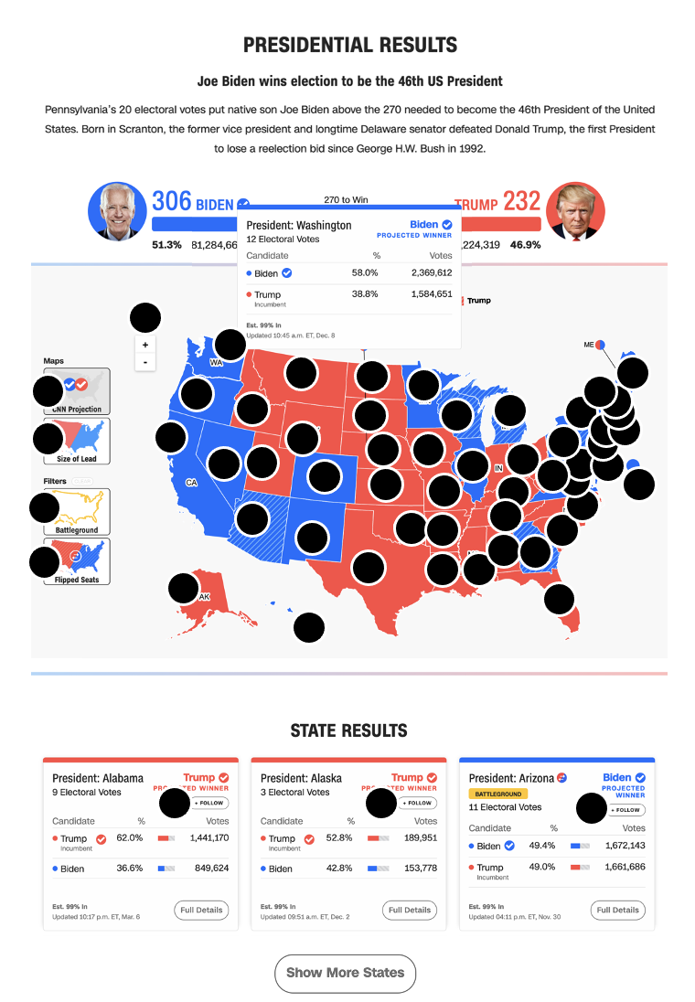
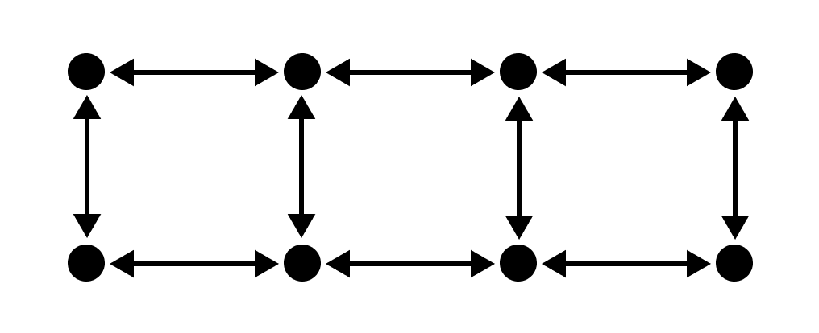

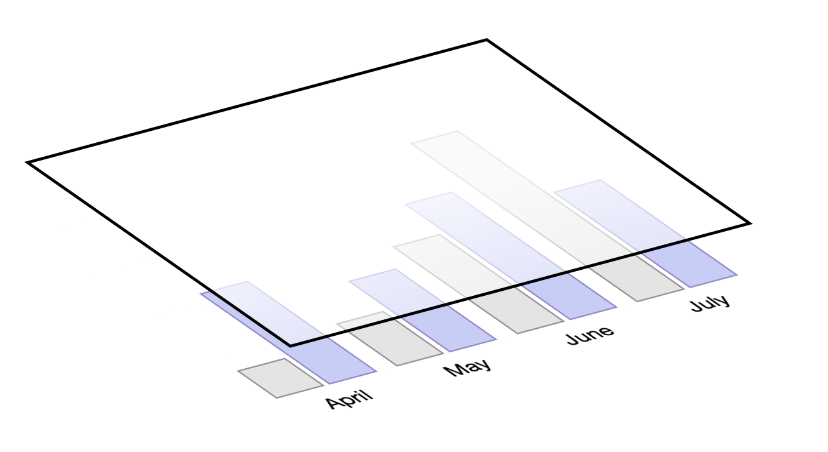
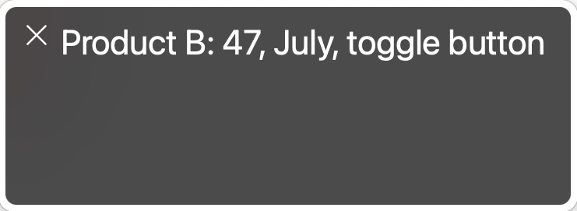
What and how of visualization accessibility
(My recent research)
Chartability:
What are accessibility barriers?
Data Navigator:
How do we build accessible visualizations?
Structure
Input
Rendering
To any visualization toolkit
Notes:
I have 2 major projects so far in my PhD, Chartability and Data Navigator. Data Navigator is my ideal tool for solving some of the hardest problems involved in making data visualizations and interactive data systems more accessible. But Chartability is about catching barriers. It’s essentially a list of 50 heuristics, with tools and methods, that practitioners can use to find accessibility barriers in their own work. Stefik and others have already talked about how certain practices, like data visualization, isn’t easily covered by WCAG and other accessibility standards. Chartability took all that it could from standards and synthesized those guidelines and tests for visualization and then we filled the rest of the gaps with research and community practices.

Slide 10
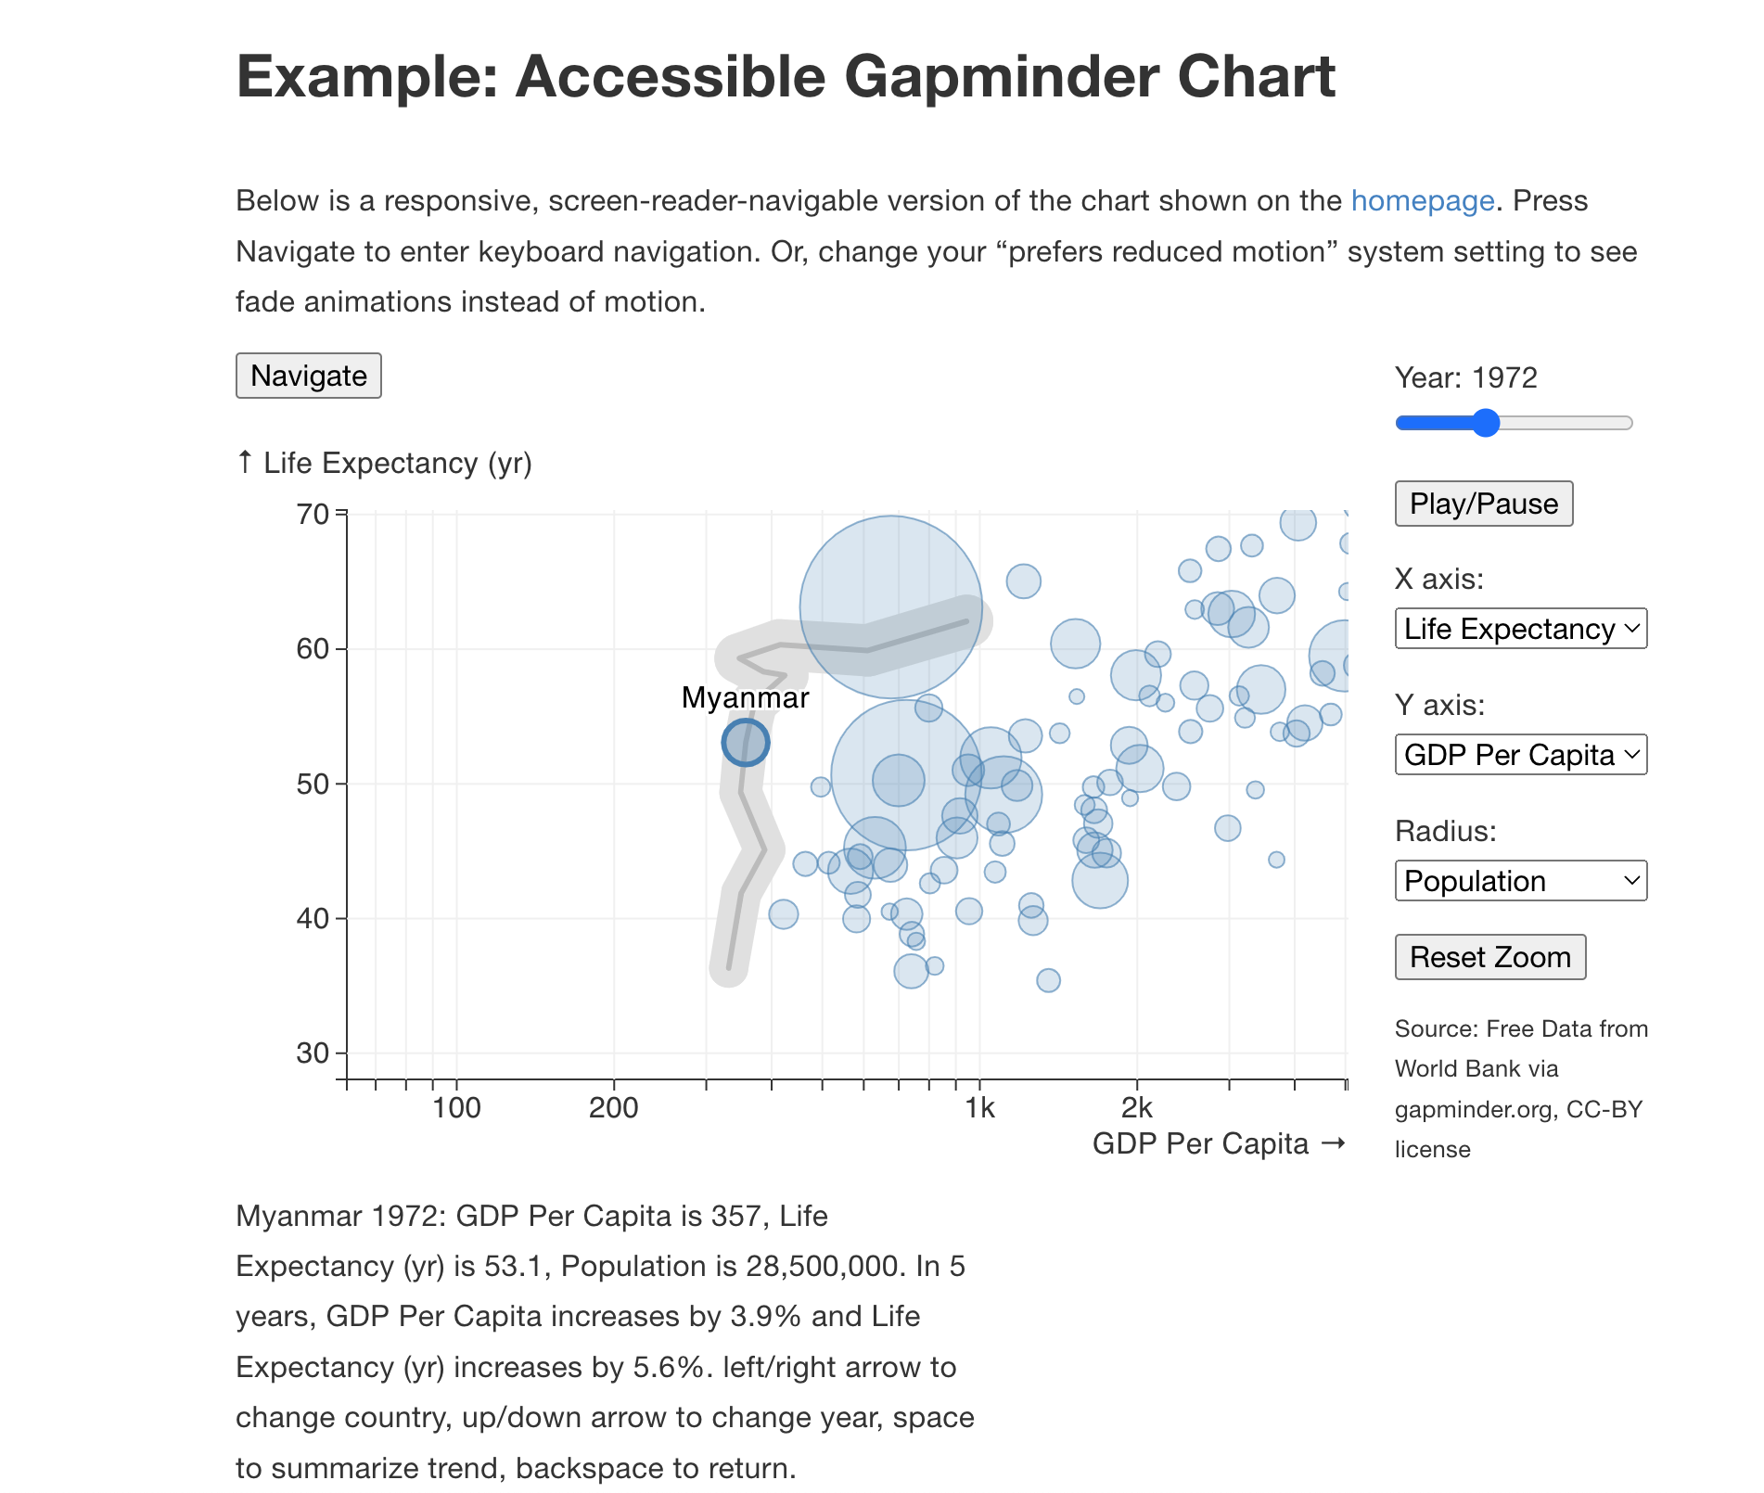
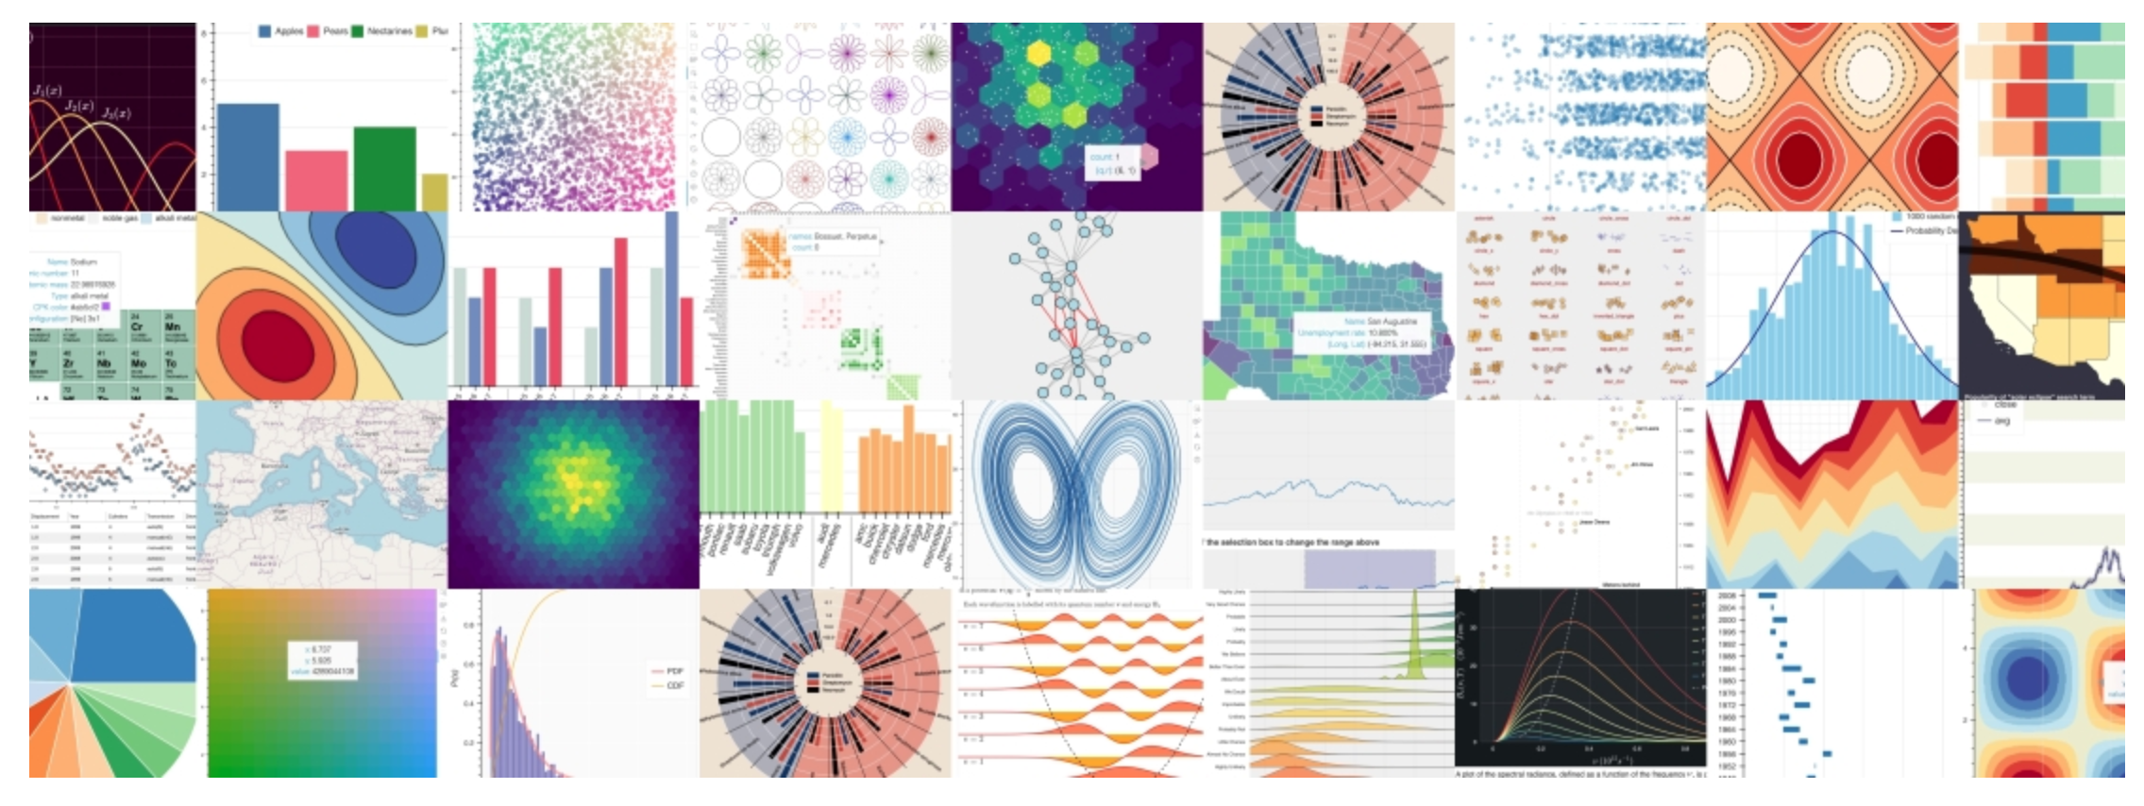
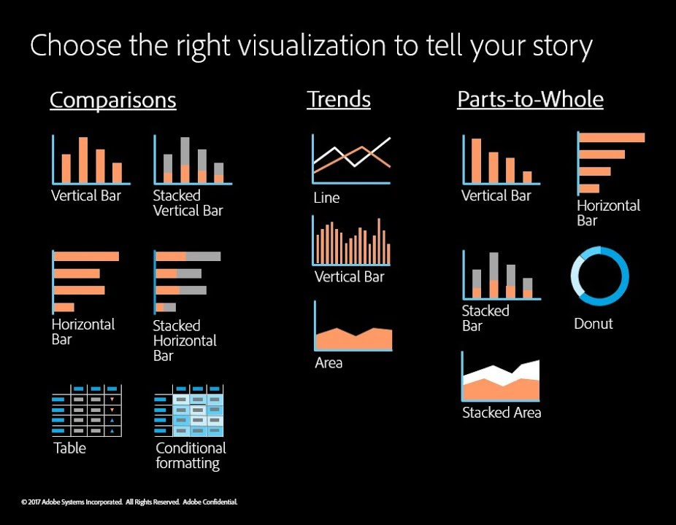
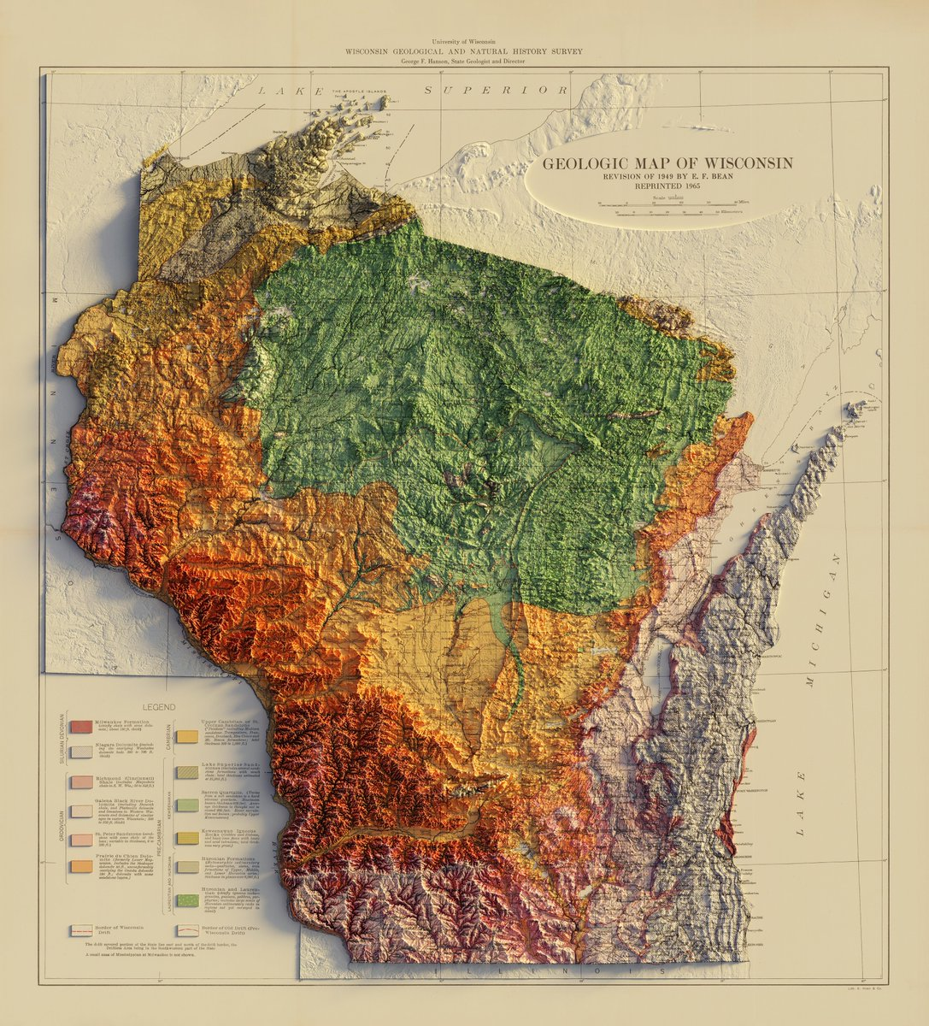
Data Navigator opened up collaborations with already-experts
Interactive demo link
Notes:
To me, Data Navigator is great. It is a project I am really excited about. I’m currently collaborating with a big data visualization library used in python called Bokeh, it gets about 4 million downloads per month and is just completely inaccessible. And I’m also working with folks at Adobe on making their charting library more accessible too.
But with education, I keep coming back to Chartability.

Slide 11
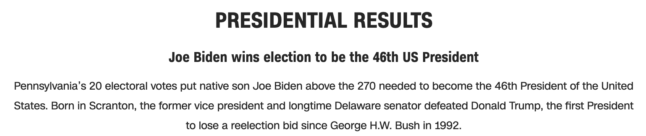
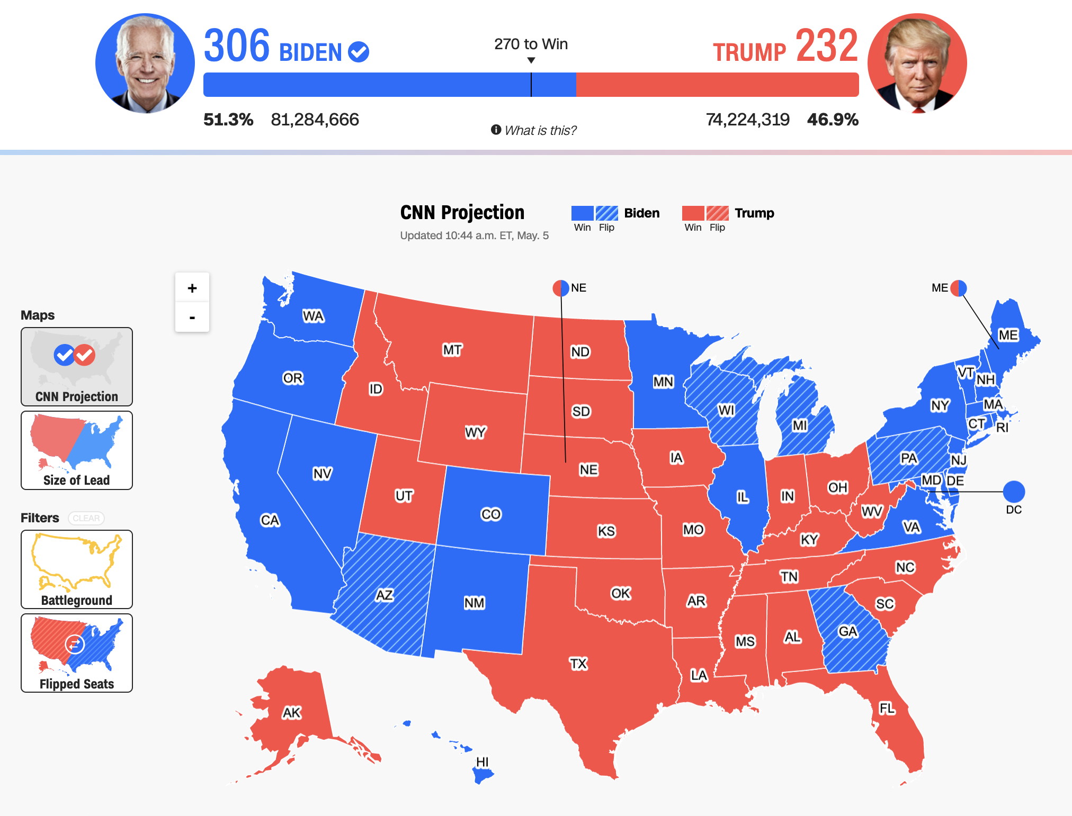
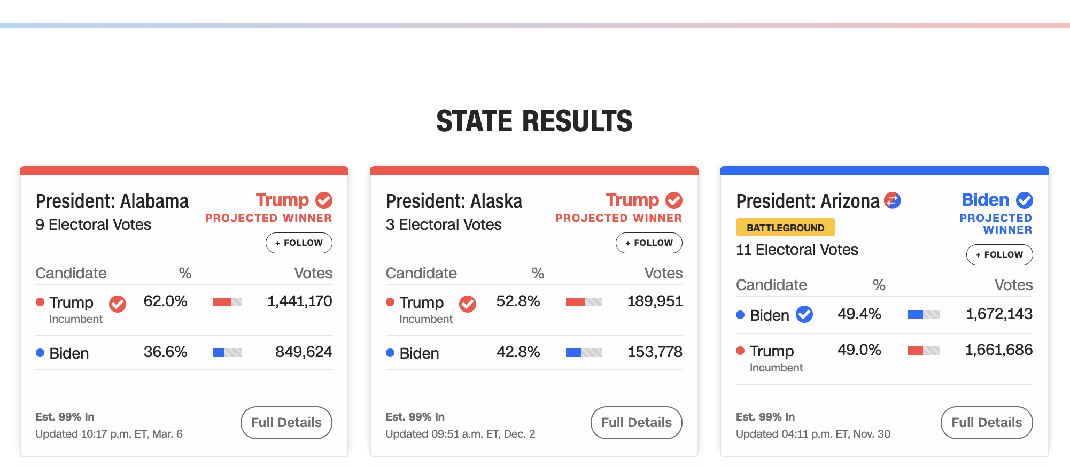

Chartability has helped me audit and train others
978 access failures found in ~60 minutes.
Robust:
275 - Does not conform to standards
82 - Semantically invalid
12 - Fragile technology support
Compromising:
54 - Information can only be reached through single process
61 - Information cannot be navigated according to narrative or structure
Assistive:
101 - Navigation and interaction is tedious
Flexible:
2 - User style change not respected
121 - User text adjustments are not respected
1 - Scrolling experiences cannot be adjusted or opted out of
Contrast and textures cannot be adjusted
Perceivable:
6 – Low contrast
57 - Content is only visual
50 - Color alone is used
3 - Meaningful elements can be distinguished
Operable:
54 - Interaction modality only has one input type
58 - No interaction cues or instructions
5 - Low contrast on interactive elements
4 - Keyboard focus indicator missing
4 - Complex actions have no alternative
18 - Target pointer interaction is too small
Understandable:
4 - Interactive context is not clear
6 - Metrics or variables are undefined
Notes:
Chartability is the subject of most of my 65 or so talks, workshops, and guest lectures that I’ve given in the past 4 years. I use it professionally to audit stuff because I still do consulting work at times, but it also helps me teach folks basic skills.
Shown on the screen here is a map of the US 202 presidential election by the folks at CNN. This is an online interactive. And in a longer workshop session, I walk folks through a live audit of this where we catch about 1000 accessibility barriers using Chartability.
But I’m running into a bit of a problem. And this is why I am thankful to be here at this workshop today.
I have open questions. Bigger things I’m worried about.

Slide 12
97-99%
Source: World Wide Web Consortium. “The WebAIM Million Report.” 2019-2024
Creators
Tools
Things
Future Things
12
Notes:
I want to go back to this problem I brought up that pretty much everything we make is inaccessible.
Sure, tens of thousands of students are learning computer science right now. And yes, we must absolutely prioritize teaching accessibility to students in integral ways. That is why we have this problem. But we also have hundreds of thousands of currently employed working professionals who don’t know about accessibility but are building the biggest and most important systems out there. These people, more senior than current students, might be managers, leads, and principal architects. More senior folks are often decision-makers, prioritizers, and budget-makers in professional contexts. But if they don’t know and don’t really care about accessibility, we have a problem.

Slide 13
Will I always be teaching primarily just the basics?
Notes:
And there is a new problem: I’m beginning to face the limits of my ability to educate folks. Chartability, to me, is the basic stuff. And I have probably done about 50 talks on just the basics of Chartability (so the basics of basics) to thousands of practitioners in the last 4 years. The whole reason I made Chartability was because I was tired of reading articles titled “top 5 things to do to make your visualization more accessible.” I wanted to know at least 45 more things than that. And being honest, I just want to talk about and educate folks on more complex, harder problems. These are fun and attractive. Educating on cutting edges stuff is hard to do though, when you only get a single 20 or 45 minute slot.
I always have Q/A sessions at the end. These Q/As, combined with my contracting and consulting work on the side, helps me get a sense of what problems folks are still wrestling with in practical settings.

Slide 14
A hard problem: Access Friction is when accessibility for someone produces a barrier for others
Notes:
An example of a common question I get is based on this issue called access friction. Practitioners who build data visualizations and who care about accessibility recognize that some designs that are accessible for certain folks aren’t accessible for others.

Slide 15
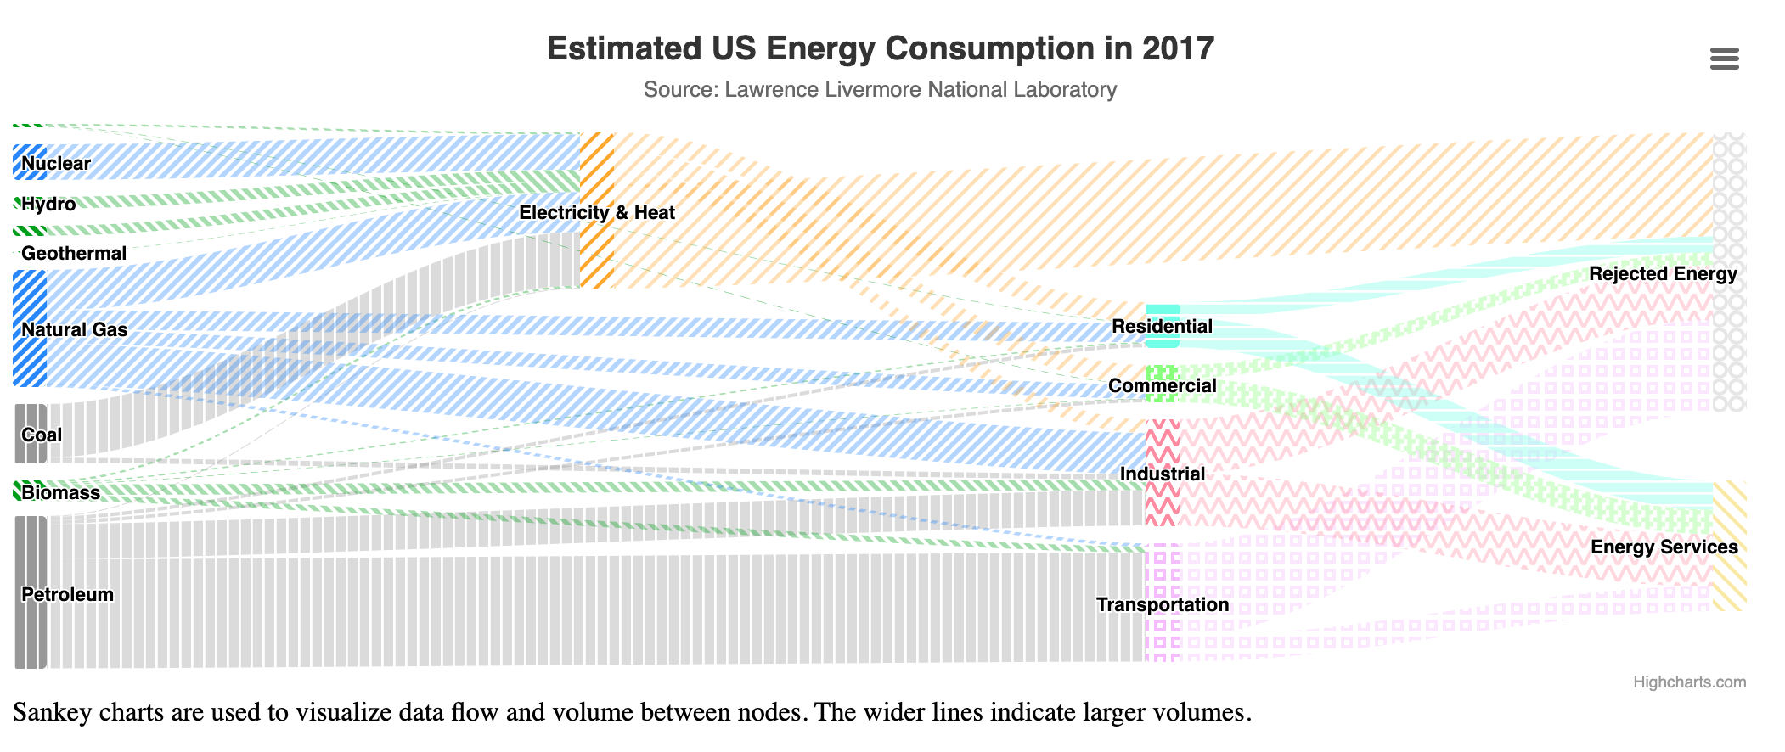
What about this is accessible? Why?
Notes:
In a recent talk, I asked a room of folks at Highsoft, which is the best company in the world building accessible data visualizations, what they think about this visualization could be considered accessible.
They said the high contrast labels with outlines, textures and colors, wide format, clear text hierarchy, explanations of what type of chart this is, etc.

Slide 16
What about this might be a barrier? Why?
Notes:
But I also ask them what about this could be considered inaccessible. And they had great answers, some of them conflict with the previous things that are accessible. For example, these textures actually make it harder to see the flows in this diagram.

Slide 17
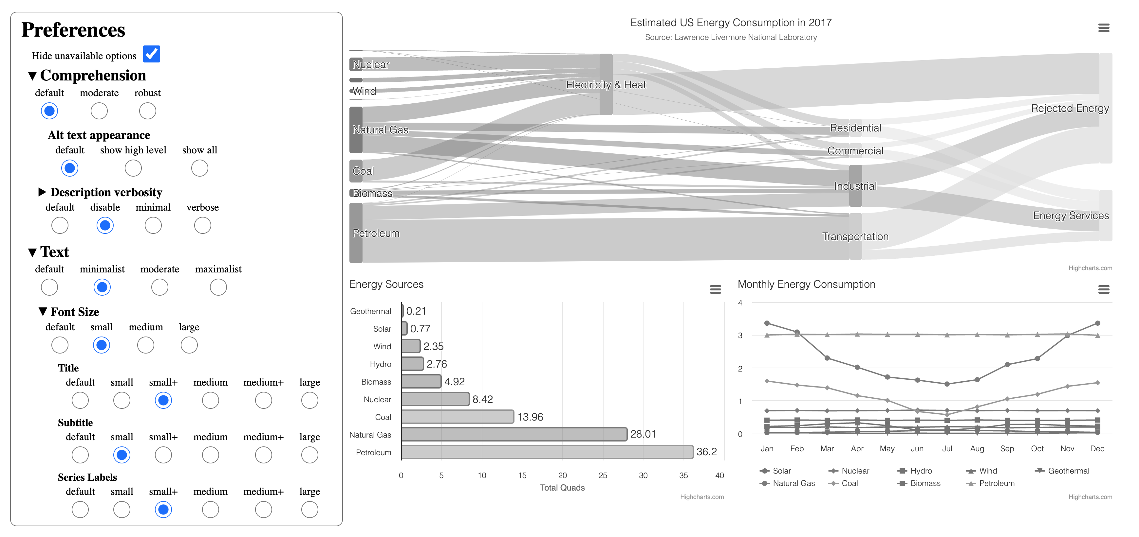
Softerware: malleable systems with guardrails
Interactive demo link
Notes:
What I’m interested in right now are how practitioners can build systems that allow end users to control the designs of systems they use regularly, like in work settings. Can we build malleable systems, but with a few guardrails in place?
I’ve got a paper on this concept I’m calling Softerware. But I’m worried about how to teach this to practitioners!
My main concern is that if I go out and teach about how we can enable users to do their own end user design, we might be setting up system builders (who if you recall do not want to make visualizations accessible) to be irresponsible.

Slide 18
How do I teach basics, responsibility, and advanced concepts to practitioners in a limited time (typically 20-45 minute sessions)?
Notes:
To me, my latest work has fundamental ethical pre-requisites. There are knowledge pre-requisites too. I can’t just teach anyone about malleable systems, or else we will end up with overlay-strategies but for my field of data visualization (for those that don’t know, overlays are lazy solutions to website inaccessibility where end users essentially need to set options for basic things).
So I want to end this little talk of mine with this problem I’m facing. Perhaps it isn’t a big problem, but to me it is. I’m sure I’m not offering a ground-breaking intellectual problem, but I went from mostly just caring about whether my work was irrelevant to now caring about whether my work will be misinterpreted and enable bad outcomes.

Slide 19
Educating Practitioners on Accessibility and Data Visualization
2025
Slides here
frank.computer
Tools, Guidelines, and Approaches to Teaching Basics
Frank Elavsky, PhD Student
hcii.cmu.edu, axle-lab.com, dig.cmu.edu
Notes:
Thank you. I am especially thankful for the chance to bring my not-too-academic style to this workshop. I genuinely hope to learn and discuss and look forward to chatting with all of you further.

